Slide 1

Objectives
In this session, you will learn to:
  Identify business functions and associated business processes
  Maintain business processes
  Introduce information systems
Notes:
Use the slide to explain the objective of the sessions to students. This session will help the student recognize functions and processes within a business organization.

Slide 2

Identifying Business Functions and Associated Business Processes
What are business functions?
Notes:
Use this and the following three slides to explain the functional, project, and multi-dimensional organizational structures to the students.

Slide 3

Identifying Business Functions and Associated Business Processes (Contd.)
Business functions enable organizations to carry out tasks to meet their goals.
Notes:
Use this and the following three slides to explain the functional, project, and multi-dimensional organizational structures to the students.

Slide 4
Identifying Business Functions and Associated Business Processes (Contd.)
Business functions are used to perform tasks, such as manufacturing, sales, and marketing.
Notes:
Use this and the following three slides to explain the functional, project, and multi-dimensional organizational structures to the students.

Slide 5
Identifying Business Functions and Associated Business Processes (Contd.)
How are these business functions performed?
Notes:
Use this and the following three slides to explain the functional, project, and multi-dimensional organizational structures to the students.

Slide 6
Identifying Business Functions and Associated Business Processes (Contd.)
Business functions are performed by using business processes.
Notes:
Use this and the following three slides to explain the functional, project, and multi-dimensional organizational structures to the students.

Slide 7
Identifying Business Functions and Associated Business Processes (Contd.)
A business process is associated with every business function.
Notes:
Use this and the following three slides to explain the functional, project, and multi-dimensional organizational structures to the students.

Slide 8
Organizational Functions and Associated Processes
The key business functions across organizations are:
  Sales and Marketing
  Production and Logistics
  Human Resources
  Finance and Accounting
  Supply Chain Management
  Customer Relationship Management
Notes:
Initiate the following discussion with the students before explaining the business functions and the associated processes.
Ask the students about the different department they can identify across organizations.
Note their responses on the white board.
Use this and the following slides to explain the same.
Note:
Inform the students that they will be learning each process in detail in the following chapters. Hence, explain all processes in brief.

Slide 9
Organizational Functions and Associated Processes (Contd.)
Sales and marketing:
  A sale is an act of providing a product/service in exchange for money.
  Marketing is an act of identifying the needs of customers and planning various activities to meet these needs.

Slide 10
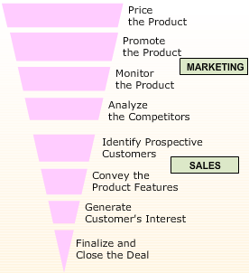
Organizational Functions and Associated Processes (Contd.)
  The following figure depicts the sales and marketing process.

Slide 11
Organizational Functions and Associated Processes (Contd.)
Production and logistics:
  Plans the materials required.
  Selects the production process.
  Ships and dispatches the finished products for distribution.

Slide 12

Organizational Functions and Associated Processes (Contd.)
  The following figure depicts the production and logistics process.

Slide 13

Organizational Functions and Associated Processes (Contd.)
Human resources:
  This division is responsible for hiring and training employees.
  The following figure depicts the human resource division of an organization.

Slide 14
Organizational Functions and Associated Processes (Contd.)
Finance and accounting:
  Prepares the budget for the organization.
  Handles accounts for all the departments of the organization.
  Generates reports including profit and loss statements, balance sheets, and general ledger statements.

Slide 15
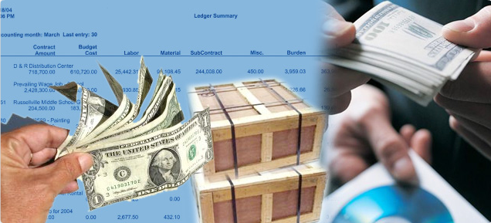
Organizational Functions and Associated Processes (Contd.)
  The following figure depicts the finance and accounting process.

Slide 16
Organizational Functions and Associated Processes (Contd.)
Supply chain management:
  Is an integrated management of all business functions and processes.
  Involves acquiring raw materials, processing them, and delivering finished products to consumers.
  Involves the following people:
    Suppliers
    Manufacturers
    Distributor
    Retailers

Slide 17
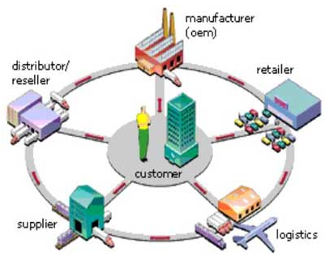
Organizational Functions and Associated Processes (Contd.)
  The following figure depicts the supply chain management process.

Slide 18

Organizational Functions and Associated Processes (Contd.)
Customer relationship management:
  It is a systematic approach towards using customer information and building long-lasting customer relationship.
  The following figures depict building relationship with customers.

Slide 19
What is Business Process Management?
Business process management:
  Is a systematic approach to improve an organization's business processes.
  Refers to a set of activities that an organization implements to optimize its business processes.
Notes:
Use this and the following slides to explain importance of maintaining and improving the business processes in an organization. Also briefly explain the Continuous Process Improvement (CPI) and Business Process Reengineering (BPR) strategies.

Slide 20
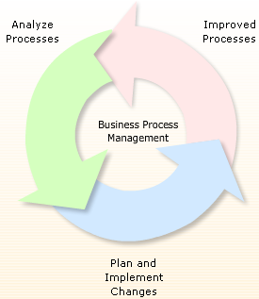
What is Business Process Management? (Contd.)
  The following figure describes the business process management.
Notes:
Use this and the following slides to explain importance of maintaining and improving the business processes in an organization. Also briefly explain the Continuous Process Improvement (CPI) and Business Process Reengineering (BPR) strategies.

Slide 21
Monitoring and Improving Processes
Why do we need to monitor business processes?
Notes:
Use this and the following three slides to explain the functional, project, and multi-dimensional organizational structures to the students.

Slide 22
Monitoring and Improving Processes (Contd.)
We need to monitor business processes to identify the areas of improvement in the processes.
Notes:
Use this and the following three slides to explain the functional, project, and multi-dimensional organizational structures to the students.

Slide 23
Monitoring and Improving Processes (Contd.)
This helps in improving the efficiency and effectiveness of business processes.
Notes:
Use this and the following three slides to explain the functional, project, and multi-dimensional organizational structures to the students.

Slide 24
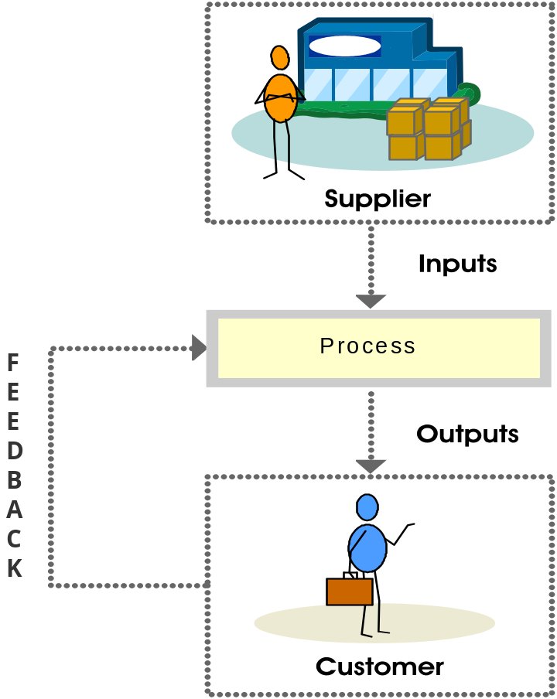
Monitoring and Improving Processes (Contd.)
The following figure depicts a typical business process flow.

Slide 25
Monitoring and Improving Processes (Contd.)
The two strategies to improve business processes of an organization are:
  Continuous Process Improvement (CPI)
  Business Process Reengineering (BPR)

Slide 26
Monitoring and Improving Processes (Contd.)
CPI:
  Attempts to understand the current processes and makes performance improvements accordingly.
  Is also known as Business Process Improvement or Functional Process Improvement.

Slide 27
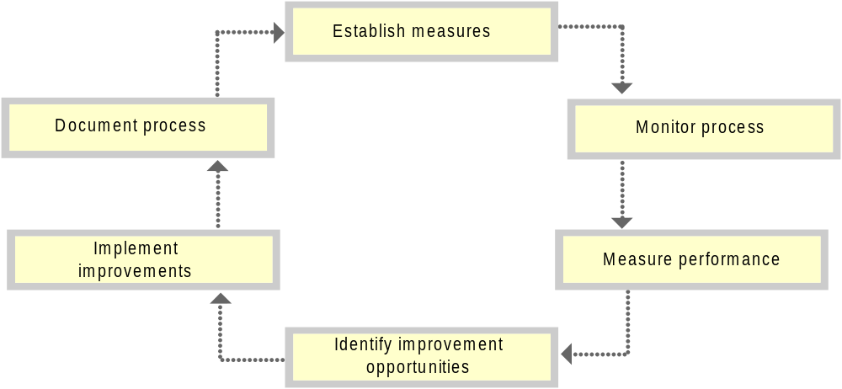
Monitoring and Improving Processes (Contd.)
  The following figure depicts the CPI Model.

Slide 28
Monitoring and Improving Processes (Contd.)
BPR:
  Is the process of making major modifications to existing organizational processes.
  Removes obsolete business processes, and then reorganize the remaining processes into an effective flow.

Slide 29
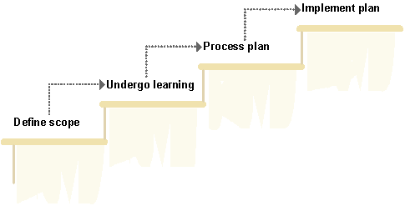
Monitoring and Improving Processes (Contd.)
  The following figure depicts the stages of implementing the BPR model.

Slide 30
Defining Information Systems
What is an information system?
Notes:
Use this and the following slides to explain the various components of Information Systems, functions performed by Information Systems, and the advantage of using Information Systems.
Example on Information System
Universities declare their annual results online. The organization that is used here is the University and the information system being used is specifically created to meet a specific business need. For example, the student roll number is an input and the displayed result is the output.
A flowchart can be created to explain the input-process-output steps that are followed in this scenario.
Ask students to identify the benefits of such a system. Then move onto how the general businesses implement the Information Systems for their daily processes.

Slide 31
Defining Information Systems (Contd.)
An information system is a group of various components, such as employees, computers, and other data processing equipments.
Notes:
Use this and the following slides to explain the various components of Information Systems, functions performed by Information Systems, and the advantage of using Information Systems.
Example on Information System
Universities declare their annual results online. The organization that is used here is the University and the information system being used is specifically created to meet a specific business need. For example, the student roll number is an input and the displayed result is the output.
A flowchart can be created to explain the input-process-output steps that are followed in this scenario.
Ask students to identify the benefits of such a system. Then move onto how the general businesses implement the Information Systems for their daily processes.

Slide 32
Defining Information Systems (Contd.)
These components help in analyzing data collected within the organization.
Notes:
Use this and the following slides to explain the various components of Information Systems, functions performed by Information Systems, and the advantage of using Information Systems.
Example on Information System
Universities declare their annual results online. The organization that is used here is the University and the information system being used is specifically created to meet a specific business need. For example, the student roll number is an input and the displayed result is the output.
A flowchart can be created to explain the input-process-output steps that are followed in this scenario.
Ask students to identify the benefits of such a system. Then move onto how the general businesses implement the Information Systems for their daily processes.

Slide 33
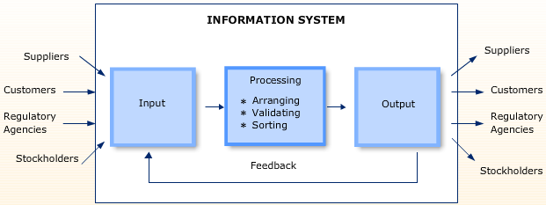
Defining Information Systems (Contd.)
An information system performs various functions in an organization.
The following figure depicts the main functions of information system.

Slide 34
Benefits of Information Systems
  It helps in the standardization of input and output.
  It generates information by organizing data in a meaningful manner.
  It enables security of information.
  It helps in analysis and decision-making.
  It saves cost and time.

Slide 35
Summary
In this session, you learned that:
  Every organization has basic functions, such as production and logistics, human resource, sales and marketing, and finance and accounting.
  Business process management is a systematic approach to improve an organization's business processes.
  Processes need to be monitored and observed to implement changes to achieve the desired results.
  The initial step towards change is Continuous Process Improvement (CPI). This model attempts to understand and measure the current process, and make performance improvements accordingly.
  Business Process Reengineering (BPR) is the act of radically altering the existing business process to arrive at the desired stage.
Notes:
Use this and the following slides to summarize the key concepts of the session to the students.

Slide 36
Summary (Contd.)
  Information is data that has been processed in a meaningful way.
  An information system is a collection of the various components of an organization that help in obtaining meaning from the data collected within the organization.
Notes:
Use this and the following slides to summarize the key concepts of the session to the students.

